Slide 1

MEng Group Project – Week 5 Propeller Clock
Edward Porter, Amin Goraine, Martin Lewis Wynne-Jones, David George, Tendai Ngoni and Miguel Santos

Slide 2
This week’s development
Last presentation’s follow up
Schematic:
High level design
Component choices
Problems and solutions
Important considerations
What comes next

Slide 3
Last presentation’s follow up
Topics covered:
Project goals and strategies
Design considerations and features (mechanical, electrical and software)
First propeller hardware’s structure design

Slide 4
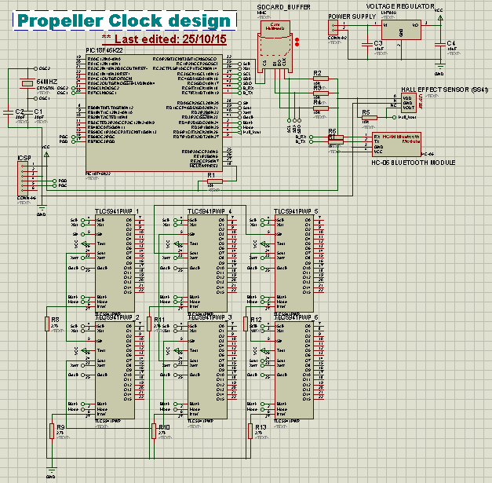
Schematic: High level design
During the start of the first semester, we developed a small and yet complete design which can carry most (if not all) of the planned features.
Abstractly, it is made with 5 main components:
The processing part (Microcontroller)
Wireless communication link (Bluetooth)
A sensor
An SD Card
An array of LEDs
The schematic is subject to alterations

Slide 5
Schematic: Component Choices
For the 5 main components, important decisions had to be made.
The Microcontroller: PIC18F46K22-I/PT (initial decision: PIC16F877A)
Wireless communication: HC-06 Bluetooth Module
Sensor: Hall Effect Sensor SS41
SD Card: Generalized SD Card adapter
LEDs:
32 RGB leds, which is equivalent to 64 bits of height and width that can be displayed
LED Driver: TLC5941PWP (initial decision: 74HC595 Shift Register)

Slide 6
Schematic: Problems and solutions
Simulation on Proteus is very limited
There are missing packages on Proteus and Ares
Challenging component acquisition due to exaggerated packs, which possibly means the budget will not be enough
Lack of experience and thus more susceptible to mistakes

Slide 7
Important considerations
All these details, specifications, datasheets, models and even the schematic are being stored on a platform dedicated for team development known as Github
All new additions that are made to the project are being recorded for possible reference

Slide 8
What comes next
Structure review and possible changes
Schematic review and decision of its final design
Printed Circuit Board layout
PIC’s firmware development
Beginning of development of the desktop application in C++ or C#

Slide 9
Any questions?

